Slide 1
Car Sales Dashboard
Internship Task 4 – Interactive Dashboard Design
Tools: Power BI | Dataset: Car Sales (Kaggle)
BY AKASH SHARMA

Slide 2
Objective
Design an interactive dashboard for business stakeholders
Track Sales, Revenue, Growth trends
Identify top-performing dealers, companies, and body styles
Enable filtering by Year and City

Slide 3
Dataset
Kaggle Car Sales dataset
24K records
Key fields: Car ID, Date, Dealer, Company, Model, Price, Body Style, Customer Info

Slide 4
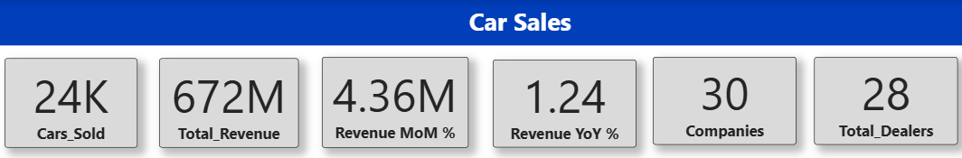
KPIs
Cars Sold → 24K
Total Revenue → 672M
Revenue MoM % → 4.36%
Revenue YoY % → 1.24%
30 Companies, 28 Dealers

Slide 5
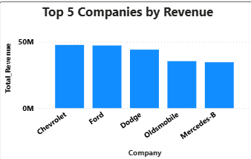
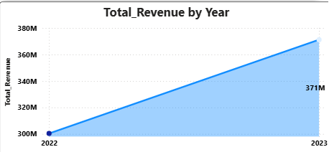
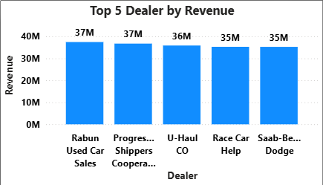
Sales Insights
Revenue by Timeline: Overall upward trend (YoY growth positive)
Top Dealers: Rabun, Progressive Shippers, U-Haul lead sales
Top Companies: Chevrolet, Ford, Dodge dominate

Slide 6
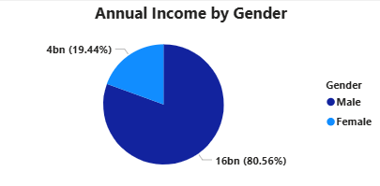
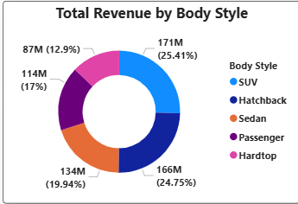
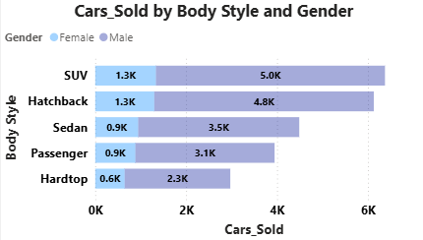
Customer Insights
Gender Split: Male customers → 80%+ revenue share
Annual Income: Male customers contribute higher purchase power
Body Style Preference: SUVs & Hatchbacks most popular

Slide 7
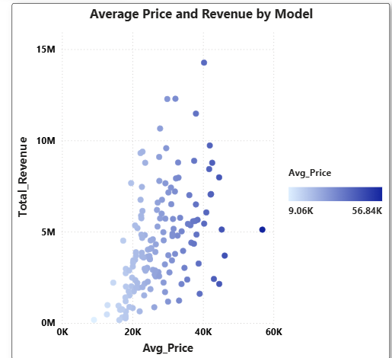
Price Insights
Scatter Plot: Higher Avg. Price correlates with higher revenue
Mid-priced cars also contribute steady revenue share

Slide 8
Conclusion
SUVs & Hatchbacks = top growth opportunity
Dealers like Rabun & Progressive Shippers drive most sales
Male buyers dominate revenue contribution → need to explore female-oriented marketing
Consistent YoY revenue growth observed

Slide 9
Thank You
Dashboard built in Power BI
Dataset: Kaggle – Car Sales
End of Presentation

